Slide 1
The Subtour LP for the Traveling Salesman Problem
(or, What I did on my sabbatical)
David P. Williamson
Cornell University
April 8, 2015
Joint work with Kyle Genova, Jiawei Qian, Frans Schalekamp, and Anke van Zuylen

Slide 2
Outline
A brief intro to the TSP
A standard TSP linear program: the Subtour LP
Experimental analysis
Theoretical analysis: an outstanding open question
A related question: the Boyd-Carr conjecture and its proof
Some conjectures and more experiments

Slide 3
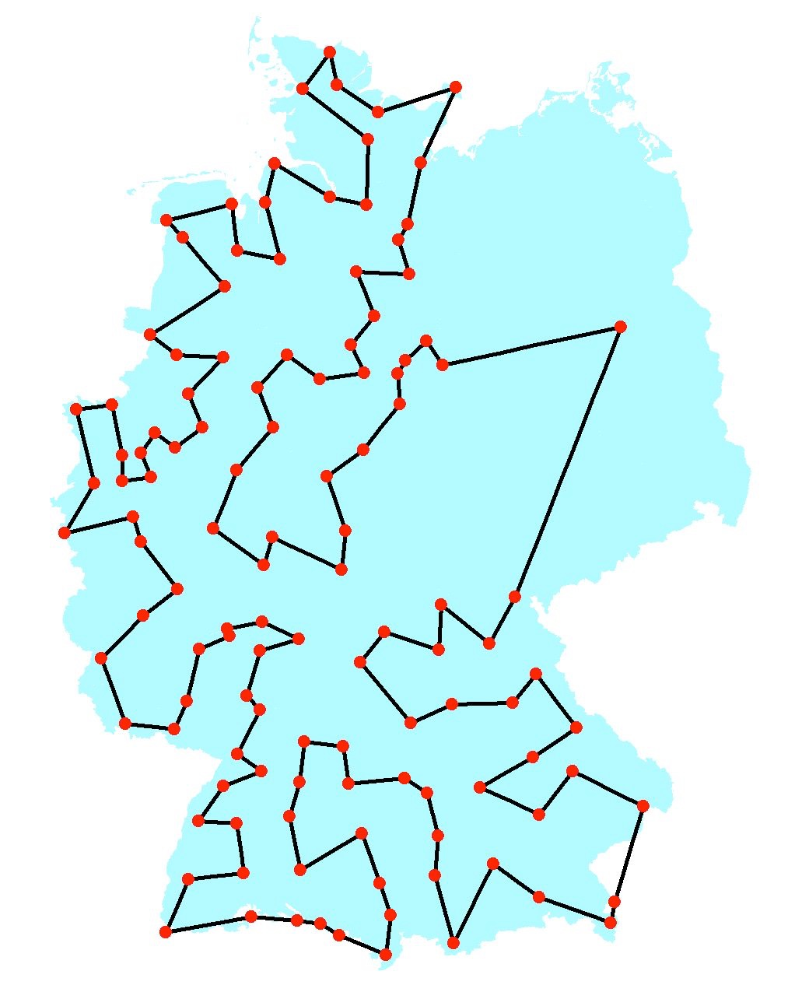
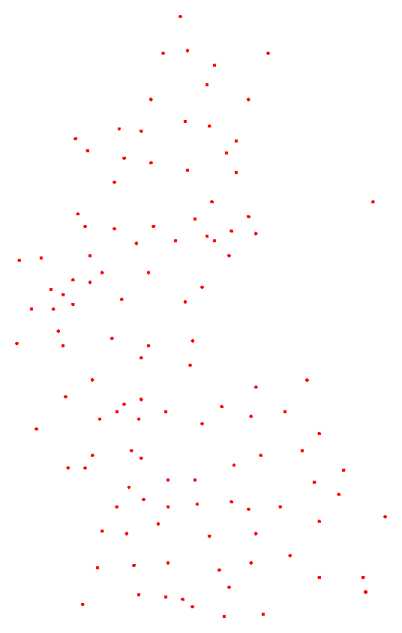
The Traveling Salesman Problem
The most famous problem in discrete optimization: Given n cities and the cost c(i,j) of traveling from city i to city j, find a minimum-cost tour that visits each city exactly once.
We assume costs are symmetric (c(i,j)=c(j,i) for all i,j) and obey the triangle inequality (c(i,j) ≤ c(i,k) + c(k,j) for all i,j,k).
120 city tour of West Germany due to
M. Grötschel (1977)

Slide 4
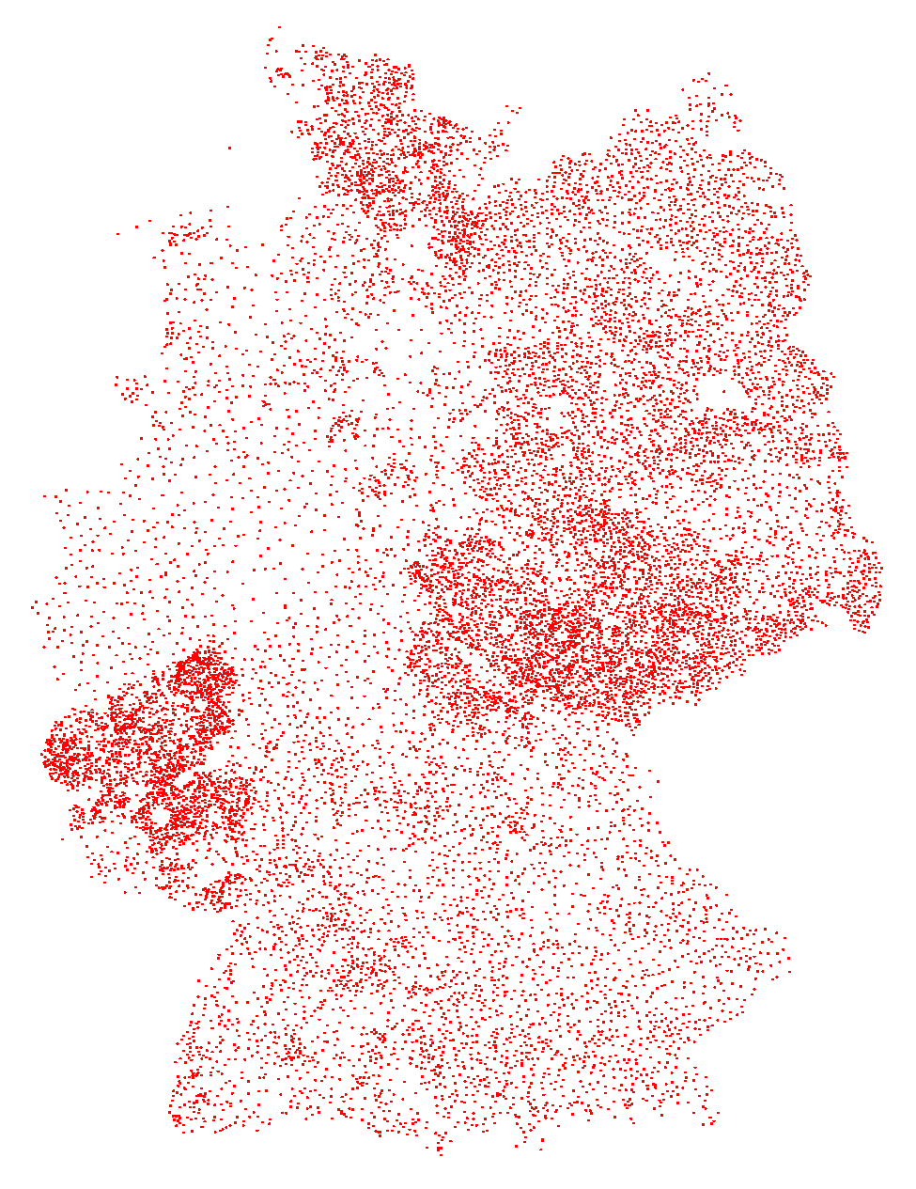
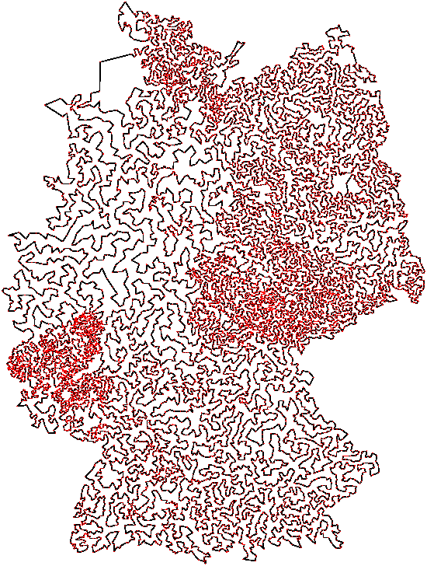
A 15112 city instance solved by Applegate, Bixby, Chvátal, and Cook (2001)

Slide 5
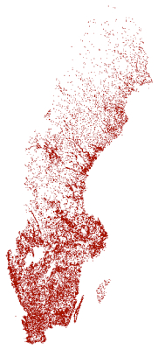
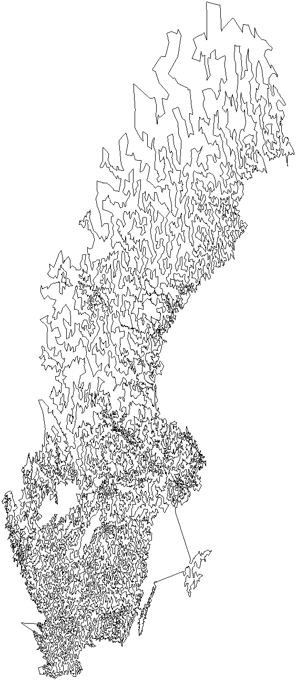
A 24978 city instance
from Sweden solved by Applegate, Bixby, Chvátal, Cook, and Helsgaun (2004)

Slide 6
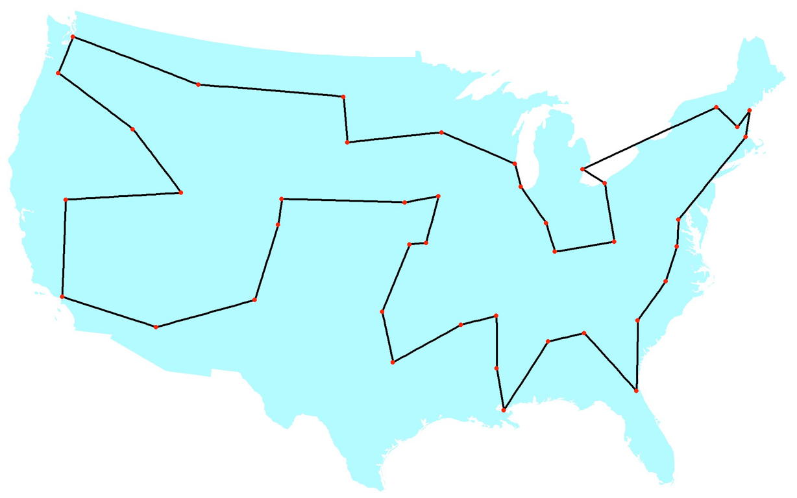
A 42 city instance
solved by Dantzig, Fulkerson, and Johnson (1954)

Slide 7
The Dantzig-Fulkerson-Johnson Method
G=(V,E) is a complete graph on |V| = n vertices
c(e)=c(i,j) is the cost of traveling on edge e=(i,j)
x(e) is a decision variable indicating if edge e is used in the tour, 0 ≤ x(e) ≤ 1
Solve linear program; if x(e) forms integer tour, stop, else find a cutting plane

Slide 8
The linear program

Slide 9
Fractional 2-matchings
Fractional (basic) solutions have components that are cycles of size at least 3 with x(e)=1 or odd cycles with x(e)=1/2 connected by paths with x(e)=1

Slide 10
2-matchings
Integer solutions have components with cycles of size at least 3; sometimes called subtours

Slide 11
“Loop conditions”
Dantzig, Fulkerson, and Johnson added constraints to eliminate subtours as they occurred; these now called “subtour elimination constraints”.
S
Edges in the cut for S

Slide 12
Subtour LP

Slide 13
Equivalent constraints
Equivalently can write subtour elimination constraints to express no cycles in any strict subset:
S

Slide 14
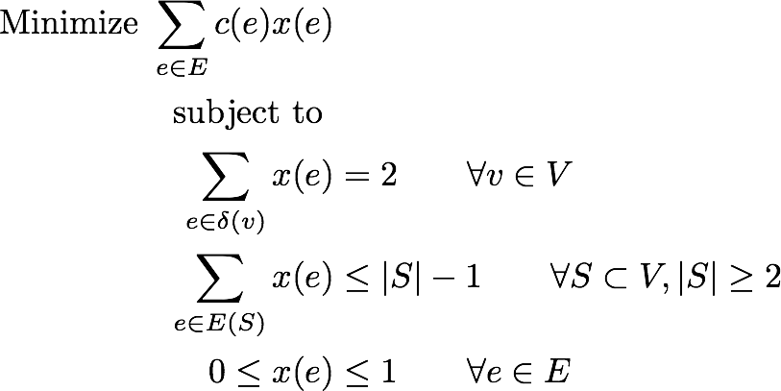
Subtour LP

Slide 15
How strong is the Subtour LP bound?
Johnson, McGeoch, and Rothberg (1996) and Johnson and McGeoch (2002) report experimentally that the Subtour LP is very close to the optimal.

Slide 16
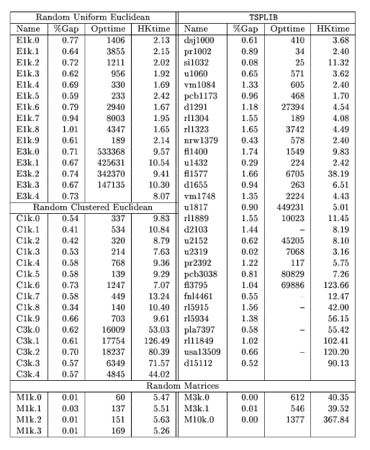

Slide 17
How strong is the Subtour LP bound?
What about in theory?
Define
SUBT(c) as the optimal value of the Subtour LP for costs c
OPT(c) as the length of the optimal tour for costs c
Cn is the set of all symmetric cost functions on n vertices that obey triangle inequality.
Then the integrality gap of the Subtour LP is

Slide 18
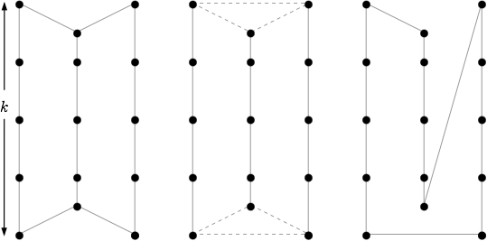
A lower bound
It’s known that γ ≥ 4/3, where c(i,j) comes from the shortest i-j path distance in a graph G (graph TSP).
Graph G
LP soln
Opt tour

Slide 19
Christofides’ Algorithm
Christofides (1976) shows how to compute a tour in polynomial time of cost 3/2 optimal: compute a min-cost spanning tree, compute a matching on the odd-degree vertices, then “shortcut” a traversal of the resulting Eulerian graph.
≤ OPT(c) +
≤ 1/2 OPT(c)
≤ 3/2 OPT(c)

Slide 20
An upper bound
Wolsey (1980) and Shmoys and W (1990) show that OPT(c) can be replaced with SUBT(c), so that Christofides gives a tour of cost ≤ 3/2 SUBT(c).
Therefore,

Slide 21
Perfect Matching Polytope
Edmonds (1965) shows that the min-cost perfect matching can be found as the solution to the linear program:

Slide 22
Matchings and the Subtour LP
Then MATCH(c) ≤ 1/2 SUBT(c) since z = 1/2 x is feasible for the matching LP.
Shmoys and W (1990) also show that SUBT(c) is nonincreasing as vertices are removed so that matching on odd-degree vertices is at most 1/2 SUBT(c).

Slide 23
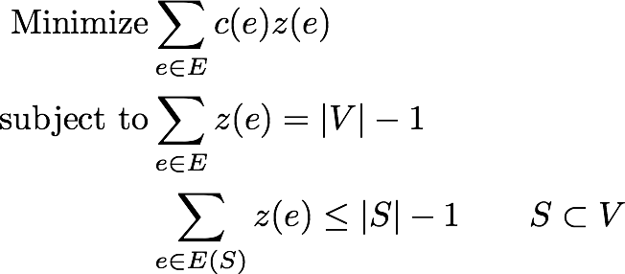
Spanning Tree Polytope
Similarly, Edmonds (1971) showed that the min-cost spanning tree can be found as the solution of the following LP:

Slide 24
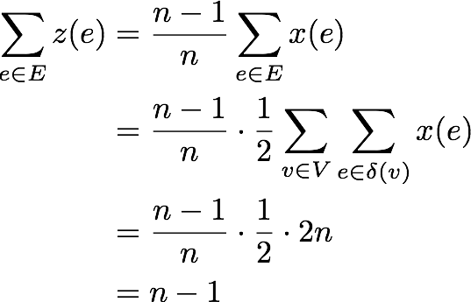
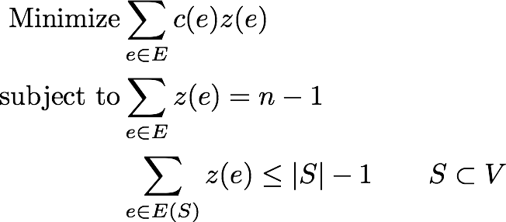
Spanning Trees and the Subtour LP
Then MST(c) ≤ ((n-1)/n) SUBT(c) since z = ((n-1)/n) x is feasible for the MST LP.

Slide 25
Recent results
Some recent progress on graph TSP (costs c(i,j) are the shortest i-j path distances in unweighted graph):
Boyd, Sitters, van der Ster, Stougie (2010); Aggarwal, Garg, Gupta (2011): Gap is at most 4/3 if graph is cubic.
Oveis Gharan, Saberi, Singh (2010): Gap is at most 3/2 - ε for a constant ε > 0.
Mömke, Svensson (2011): Gap is at most 1.461.
Mömke, Svensson (2011): Gap is 4/3 if graph is subcubic (degree at most 3).
Mucha (2011): Gap is at most 13/9 ≈ 1.44.
Sebő and Vygen (2012): Gap is at most 1.4.

Slide 26
Aug 2012?

Slide 27
Current state
Conjecture (Goemans 1995, others):

Slide 28
More ignorance
Let γ₁₂ be the integrality gap for costs c(i,j) ∈ {1,2}. Then all we know is
cost 1 edges
LP soln
OPT

Slide 29
Still more ignorance
We don’t even know the equivalent worst-case ratio between 2-matching costs 2M(c) and SUBT(c).
Then all we know is that
Conjecture (Boyd, Carr 2011):

Slide 30
Our contributions
We can prove the Boyd-Carr conjecture (with Schalekamp and van Zuylen)
We can show γ₁₂ ≤ 5/4 (with Qian, Schalekamp, and van Zuylen).

Slide 31
Outline
A brief intro to the TSP
A standard TSP linear program
Experimental analysis
Theoretical analysis: an outstanding open question
A related question: the Boyd-Carr conjecture and its proof
μ ≤ 4/3 under a certain condition.
μ ≤ 10/9.
Some conjectures and more experiments

Slide 32
Some terminology
Cut edge
Path edge x(e)=1
Cycle edge x(e)=1/2

Slide 33
The strategy
Start with an optimal fractional 2-matching; this gives a lower bound on the Subtour LP.
Add a low-cost set of edges to create a graphical 2-matching: each vertex has degree 2 or 4; each component has size at least 3; each edge has 0, 1, or 2 copies.
“Shortcut” the graphical 2-matching to a 2-matching.

Slide 34
The strategy
For each (fractional) component of the fractional 2-matching:
Create a new graph from the component with edge costs; keep all cycle edges, replace paths in some way.
Solve a min-cost perfect matching in the new graph.
For each cycle edge in the matching, remove the cycle edge from the graph; various tricks for path edges in the matching.
Show that this creates a graphical 2-matching.

Slide 35
Consider fractional 2-matchings that have no cut edge; we show that we can get a graphical 2-matching with a 4/3 increase in cost.
2M ≤
Graphical 2M ≤ 4/3 Fractional 2M
≤ 4/3 Subtour

Slide 36
Create new graph by replacing path edges with a single edge of cost equal to the path, cycle edges with negations of their cost.
c1
c2
c1+c2
c
-c
c’
-c’
New graph is cubic and 2-edge connected.

Slide 37
Compute a min-cost perfect matching in new graph.
c1+c2
-c’
In the fractional 2-matching, double any path edge in matching, remove any cycle edge. Cost is paths + cycles + matching edges.
c1
c2
c1+c2
2c1+2c2
c
c
c’
-c’
0

Slide 38
Why this works
For any given node on the cycle, either its associated path edge is in the matching or one of the two cycle edges.
Notes:
Note that every component will have size at least 3.

Slide 39
Why this works
For any given node on the path, either its associated path edge is in the matching or not.
Notes:
Note that every component will have size at least 3.

Slide 40
Bounding the cost
P = total cost of all path edges
C = total cost all cycle edges
So fractional 2-matching costs P + C/2
Claim: Perfect matching in the new graph costs at most 1/3 the cost of all its edges, so at most 1/3(P - C)

Slide 41
Bounding the cost
Since the graphical 2-matching costs at most P + C + matching, it costs at most
2M ≤
Graphical 2M ≤ 4/3 Fractional 2M
≤ 4/3 Subtour

Slide 42
Matching cost
Naddef and Pulleyblank (1981): Any cubic, 2-edge-connected, weighted graph has a perfect matching of cost at most a third of the sum of the edge weights.
Proof: Set z(e)=1/3 for all e∈E, then feasible for matching LP.
⅓
⅓
⅓
⅓
⅓
⅓
⅓
⅓
3|S| = 2|E(S)| + |δ(S)|, so for |S| odd, |δ(S)| odd.
⅓

Slide 43
How to do better
Idea of Boyd and Carr (1999): Instead of duplicating an entire path, consider patterns.

Slide 44
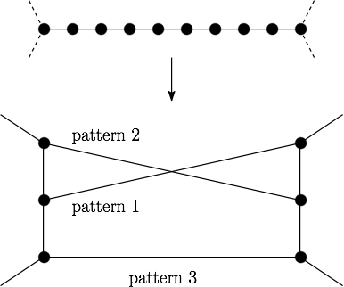
In new graph, replace every path with a pattern gadget; if the corresponding edge is in the matching, then we will use that pattern in the 2-matching.
Cost of pattern edge is difference in cost between pattern and path; other new edges have cost 0

Slide 45
Some observations
Replace other paths with a single edge of cost equal to the path, other cycle edges of cost c with edge of cost -c.
Because we replace paths of cut edges with a pattern gadget, the resulting graph is again cubic and 2-edge-connected, so Naddef and Pulleyblank applies.
Given a matching, we use patterns indicated, delete cycle edges in matching, duplicate path edges in matching. Claim this results in a graphical 2-matching.

Slide 46
Bounding the cost
CP = cost of paths of cut edges
P = cost of paths that aren’t cut edges
C = cost of cycle edges
Fractional 2-matching costs CP + P + C/2
Matching costs at most 1/3(P + 4CP - C)
So overall cost of graphical 2-matching is

Slide 47
Why does this help?
Intuition: Now we can get a cheaper matching.

Slide 48
If any cycle edge in the cut, then at least two plus one more by parity: 4/9 + 4/9 + 1/9
If no cycle edge in the cut, then at least 9 pattern edges.
Can show matching has cost at most 1/9 P - 4/9 C

Slide 49
Costs
Cost of pattern edge: cost of pattern minus cost of path. So total cost of pattern edges in matching is 4P - 3P = P.
Cost of cycle edge: negative of cost of edge.
If no pattern edge in matching, then insert the path.

Slide 50
Bounding the cost
P = total cost of all path edges
C = total cost all cycle edges
So fractional 2-matching costs P + C/2
Matching costs at most 1/9 P - 4/9 C
So graphical 2-matching costs

Slide 51
Bounding the cost
P = total cost of all path edges
C = total cost all cycle edges
So fractional 2-matching costs P + C/2
Perfect matching in the new graph costs at most 1/9 P - 4/9 C

Slide 52
Bounding the cost
Can show again that the graphical 2-matching costs at most P + C + matching, so it costs at most
2M ≤
Graphical 2M ≤ 10/9 Fractional 2M
≤ 10/9 Subtour

Slide 53
Proving μ ≤ 10/9
To prove stronger results, we give a polyhedral formulation for graphical 2-matchings.
For all i∈V, create i’ and i’’
i’ required: must have degree 2
i’’ optional: may have degree 0 or 2
For all (i,j)∈E, create edges (i’,j’), (i’,j’’), (i’’,j’)
i’
j’
k’
i’’
j’’
k’’

Slide 54
The formulation
Can show that the extreme points of this LP are graphical 2-matchings.

Slide 55
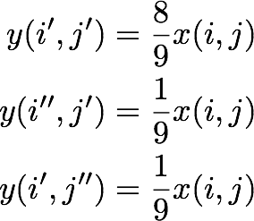
Proving μ ≤10/9
Given Subtour LP soln x, set

Slide 56
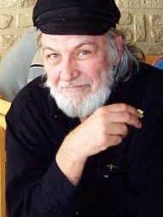
Edmonds (1967)

Slide 57
Some conjectures
For the 1,2-TSP we conjecture that γ₁₂ = 10/9. We show γ₁₂ ≤ 5/4.
Computation shows the conjecture is true for n ≤ 12.

Slide 58
An observation
We know
We conjecture γ ≤ 4/3, γ₁₂ ≤ 10/9.
Coincidence?

Slide 59
Another conjecture
Conjecture: The worst case for the Subtour LP integrality gap (both γ and γ₁₂) occurs for solutions that are fractional 2-matchings.
Note: we don’t even know tight bounds on γ and γ₁₂ in this case, though we can show γ₁₂ ≤ 7/6 in this case.

Slide 60
Best-of-Many Christofides’
A conjectured algorithm (Oveis Gharan, Saberi, Singh 2010; An, Kleinberg, Shmoys 2012):
Solve Subtour LP for x.
Since ((n-1)/n)x in spanning tree polytope, express ((n-1)/n)x as a convex combination of spanning trees.
Sample a spanning tree from convex combination, run Christofides’ algorithm on it.

Slide 61
Experimental Results
 | Std | Max Entropy (Best) | Max Entropy (Ave) | Splitting Off (Best) | Splitting Off (Ave)
TSPLIB | 9.45% | 3.47% | 6.29% | 5.42% | 6.34%
VLSI | 9.87% | 5.84% | 7.52% | 6.43% | 7.42%
Graph | 14.68% | 0.51% | 0.89% | 1.34% | 1.61%
Percentages expressed with respect to cost of an optimal tour
(With Kyle Genova)

Slide 62
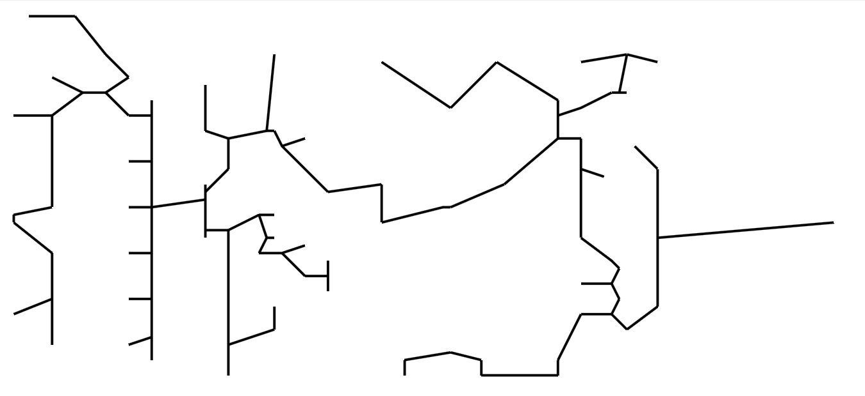
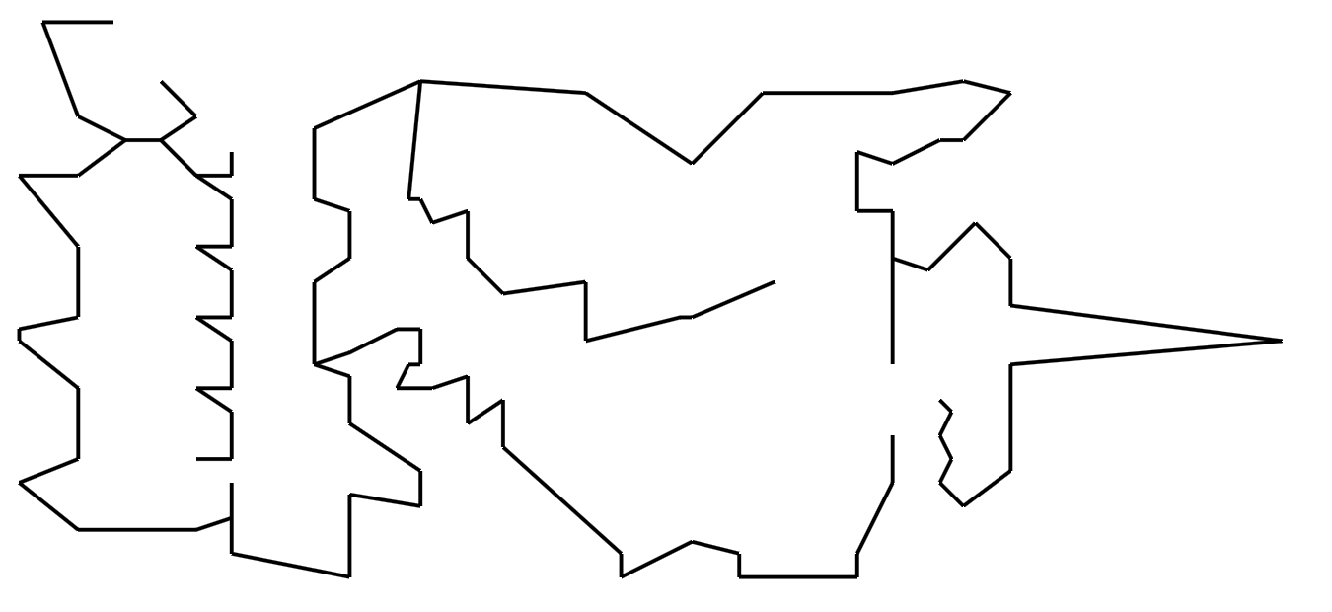
Why does this help?
Experimentally, almost all degrees of sampled spanning tree are two. The tree costs more, and matching edges are more expensive, but there are a lot fewer edges in the matching.
Standard Christofides’
Best-of-Many Christofides’

Slide 63
Experimental Results
 | Tree |  | Matching
 | Std | Best of Many | Std | Max Entropy | Splitting Off
TSPLIB | 87.85% | 98.79% | 31.06% | 10.80% | 10.63%
VLSI | 90.57% | 98.92% | 29.46% | 12.60% | 12.49%
Graph | 77.59% | 98.78% | 42.35% | 3.16% | 5.37%
Percentages expressed with respect to cost of an optimal tour

Slide 64
Analysis
E[cost of tree] ≤ SUBT(c) by construction.
Would need to show E[cost of matching] ≤ (1/2 - ε) SUBT(c) for some ε > 0.

Slide 65
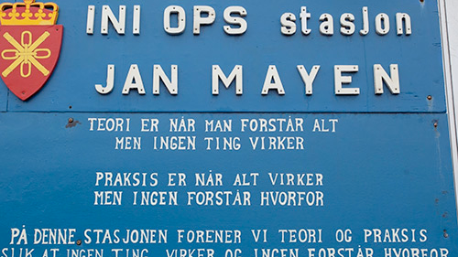
“Theory is when we understand everything, but nothing works.
Practice is when everything works, but we don’t understand why.
At this station, theory and practice are united, so that nothing works and no one understands why.”

Slide 66
Thank you for your attention.

